Slide 1
Cache Architectures

Slide 2
What Will We Learn ?
Brief review of how data can be stored
Memory System Performance Analysis
Caches

Slide 3
Review: What were Memory Elements ?
Memories are large blocks
A significant portion of a modern circuit is memory.
Memories are practical tools for system design
Programmability, reconfigurability all require memory
Allows you to store data and work on stored data
Not all algorithms are designed to process data as it comes, some require data to be stored.
Data type determines required storage
SMS: 160 bytes
1 second normal audio: 64 kbytes
1 HD picture: 7.32 Mbytes

Slide 4
How Can We Store Data
Flip-Flops (or Latches)
Very fast, parallel access
Expensive (one bit costs 20+ transistors)
Static RAM
Relatively fast, only one data word at a time
Less expensive (one bit costs 6 transistors)
Dynamic RAM
Slower, reading destroys content (refresh), one data word at a time, needs special process
Cheaper (one bit is only a transistor)
Other storage technology (hard disk, flash)
Much slower, access takes a long time, non-volatile
Per bit cost is lower (no transistors directly involved)

Slide 5
Array Organization of Memories
Efficiently store large amounts of data
Consists of a memory array to store data
The address selects one row of the array
The data in the row is read out
An M-bit value can be read or written at each unique N-bit address
All values in array can be accessed
… but only M-bits at a time

Slide 6
Memory Arrays

Slide 7
Introduction
Computer performance depends on:
Processor performance
Memory system performance

Slide 8
Introduction
Up until now, assumed memory could be accessed in 1 clock cycle
But that hasn’t been true since the 1980’s

Slide 9
Memory System Challenge
Make memory system appear as fast as processor
Use a hierarchy of memories
Ideal memory:
Fast
Cheap (inexpensive)
Large (capacity)
But we can only choose two!

Slide 10
Memory Hierarchy

Slide 11
Locality
Exploit locality to make memory accesses fast
Temporal Locality:
Locality in time (e.g., if looked at a Web page recently, likely to look at it again soon)
If data used recently, likely to use it again soon
How to exploit: keep recently accessed data in higher levels of memory hierarchy
Spatial Locality:
Locality in space (e.g., if read one page of book recently, likely to read nearby pages soon)
If data used recently, likely to use nearby data soon
How to exploit: when accessing data, bring nearby data into higher levels of memory hierarchy too

Slide 12
Memory Performance
Hit: is found in that level of memory hierarchy
Miss: is not found (must go to next level)
Hit Rate = # hits / # memory accesses = 1 – Miss Rate
Miss Rate = # misses / # memory accesses = 1 – Hit Rate
Average memory access time (AMAT): average time it takes for processor to access data
AMAT = t_{cache} + MR_{cache}[t_{MM} + MR_{MM}(t_{VM})]

Slide 13
Memory Performance Example 1
A program has 2,000 load and store instructions. 1,250 of these data values found in cache. The rest are supplied by other levels of memory hierarchy
What are the hit and miss rates for the cache?
Hit Rate =
Miss Rate =

Slide 14
Memory Performance Example 1
A program has 2,000 load and store instructions. 1,250 of these data values found in cache. The rest are supplied by other levels of memory hierarchy
What are the hit and miss rates for the cache?
Hit Rate = 1250/2000 = 0.625
Miss Rate = 750/2000 = 0.375 = 1 – Hit Rate

Slide 15
Memory Performance Example 2
Suppose a processor has 2 levels of hierarchy: cache and main memory:
t_{cache} = 1 cycle,
t_{MM} = 100 cycles
What is the AMAT of the program from Example 1?
AMAT =

Slide 16
Memory Performance Example 2
Suppose a processor has 2 levels of hierarchy: cache and main memory:
t_{cache} = 1 cycle,
t_{MM} = 100 cycles
What is the AMAT of the program from Example 1?
AMAT = t_{cache} + MR_{cache}(t_{MM})
= [1 + 0.375(100)] cycles
= 38.5 cycles

Slide 17
Cache
A safe place to hide things
Highest level in memory hierarchy
Fast (typically ~ 1 cycle access time)
Ideally supplies most of the data to the processor
Usually holds most recently accessed data

Slide 18
Cache Design Questions
What data is held in the cache?
How is data found?
What data is replaced?
We’ll focus on data loads, but stores follow same principles

Slide 19
What data is held in the cache?
Ideally, cache anticipates data needed by processor and holds it in cache
But impossible to predict future
So, use past to predict future – temporal and spatial locality:
Temporal locality: copy newly accessed data into cache. Next time it’s accessed, it’s available in cache.
Spatial locality: copy neighboring data into cache too. Block size = number of bytes copied into cache at once.

Slide 20
Cache Terminology
Capacity (C):
the number of data bytes a cache stores
Block size (b):
bytes of data brought into cache at once
Number of blocks (B = C/b):
number of blocks in cache: B = C/b
Degree of associativity (N):
number of blocks in a set
Number of sets (S = B/N):
each memory address maps to exactly one cache set

Slide 21
How is data found?
Cache organized into S sets
Each memory address maps to exactly one set
Caches categorized by number of blocks in a set:
Direct mapped: 1 block per set
N-way set associative: N blocks per set
Fully associative: all cache blocks are in a single set
Examine each organization for a cache with:
Capacity (C = 8 words)
Block size (b = 1 word)
So, number of blocks (B = 8)

Slide 22
Direct Mapped Cache

Slide 23
Direct Mapped Cache Hardware

Slide 24
Direct Mapped Cache Performance
# MIPS assembly code
addi $t0, $0, 5
loop: beq $t0, $0, done
lw $t1, 0x4($0)
lw $t2, 0xC($0)
lw $t3, 0x8($0)
addi $t0, $t0, -1
j loop
done:
Miss Rate =

Slide 25
Direct Mapped Cache Performance
# MIPS assembly code
addi $t0, $0, 5
loop: beq $t0, $0, done
lw $t1, 0x4($0)
lw $t2, 0xC($0)
lw $t3, 0x8($0)
addi $t0, $t0, -1
j loop
done:
Miss Rate = 3/15 = 20%
Temporal Locality Compulsory Misses

Slide 26
Direct Mapped Cache: Conflict
# MIPS assembly code
addi $t0, $0, 5
loop: beq $t0, $0, done
lw $t1, 0x4($0)
lw $t2, 0x24($0)
addi $t0, $t0, -1
j loop
done:
Miss Rate =

Slide 27
Direct Mapped Cache: Conflict
# MIPS assembly code
addi $t0, $0, 5
loop: beq $t0, $0, done
lw $t1, 0x4($0)
lw $t2, 0x24($0)
addi $t0, $t0, -1
j loop
done:
Miss Rate = 10/10 = 100%
Conflict Misses

Slide 28
N-Way Set Associative Cache

Slide 29
N-way Set Associative Performance
# MIPS assembly code
addi $t0, $0, 5
loop: beq $t0, $0, done
lw $t1, 0x4($0)
lw $t2, 0x24($0)
addi $t0, $t0, -1
j loop
done:
Miss Rate =

Slide 30
N-way Set Associative Performance
# MIPS assembly code
addi $t0, $0, 5
loop: beq $t0, $0, done
lw $t1, 0x4($0)
lw $t2, 0x24($0)
addi $t0, $t0, -1
j loop
done:
Miss Rate = 2/10
= 20%
Associativity reduces conflict misses

Slide 31
Fully Associative Cache
No conflict misses
Expensive to build

Slide 32
Spatial Locality?
Increase block size:
Block size, b = 4 words
C = 8 words
Direct mapped (1 block per set)
Number of blocks, B = C/b = 8/4 = 2

Slide 33
Direct Mapped Cache Performance
addi $t0, $0, 5
loop: beq $t0, $0, done
lw $t1, 0x4($0)
lw $t2, 0xC($0)
lw $t3, 0x8($0)
addi $t0, $t0, -1
j loop
done:
Miss Rate =

Slide 34
Direct Mapped Cache Performance
addi $t0, $0, 5
loop: beq $t0, $0, done
lw $t1, 0x4($0)
lw $t2, 0xC($0)
lw $t3, 0x8($0)
addi $t0, $t0, -1
j loop
done:
Miss Rate = 1/15
= 6.67%
Larger blocks reduce compulsory misses through spatial locality

Slide 35
Cache Organization Recap
Main Parameters
Capacity: C
Block size: b
Number of blocks in cache: B = C/b
Number of blocks in a set: N
Number of Sets: S = B/N
Organization | Number of Ways (N) | Number of Sets (S = B/N)
Direct Mapped | 1 | B
N-Way Set Associative | 1 < N < B | B / N
Fully Associative | B | 1

Slide 36
Capacity Misses
Cache is too small to hold all data of interest at one time
If the cache is full and program tries to access data X that is not in cache, cache must evict data Y to make room for X
Capacity miss occurs if program then tries to access Y again
X will be placed in a particular set based on its address
In a direct mapped cache, there is only one place to put X
In an associative cache, there are multiple ways where X could go in the set.
How to choose Y to minimize chance of needing it again?
Least recently used (LRU) replacement: the least recently used block in a set is evicted when the cache is full.

Slide 37
Types of Misses
Compulsory: first time data is accessed
Capacity: cache too small to hold all data of interest
Conflict: data of interest maps to same location in cache
Miss penalty: time it takes to retrieve a block from lower level of hierarchy

Slide 38
LRU Replacement
# MIPS assembly
lw $t0, 0x04($0)
lw $t1, 0x24($0)
lw $t2, 0x54($0)

Slide 39
LRU Replacement
# MIPS assembly
lw $t0, 0x04($0)
lw $t1, 0x24($0)
lw $t2, 0x54($0)

Slide 40
Caching Summary
What data is held in the cache?
Recently used data (temporal locality)
Nearby data (spatial locality, with larger block sizes)
How is data found?
Set is determined by address of data
Word within block also determined by address of data
In associative caches, data could be in one of several ways
What data is replaced?
Least-recently used way in the set

Slide 41
Miss Rate Data
Bigger caches reduce capacity misses
Greater associativity reduces conflict misses
Adapted from Patterson & Hennessy, Computer Architecture: A Quantitative Approach

Slide 42
Miss Rate Data
Bigger block size reduces compulsory misses
Bigger block size increases conflict misses

Slide 43
Multilevel Caches
Larger caches have lower miss rates, longer access times
Expand the memory hierarchy to multiple levels of caches
Level 1: small and fast (e.g. 16 KB, 1 cycle)
Level 2: larger and slower (e.g. 256 KB, 2-6 cycles)
Even more levels are possible

Slide 44
Intel Pentium III Die

Slide 45
Virtual Memory
Gives the illusion of a bigger memory without the high cost of DRAM
Main memory (DRAM) acts as cache for the hard disk

Slide 46
The Memory Hierarchy
Physical Memory: DRAM (Main Memory)
Faster, Not so large, Expensive
Virtual Memory: Hard disk
Slow, Large, Cheap

Slide 47
The Hard Disk

Slide 48
Virtual Memory
Each program uses virtual addresses
Entire virtual address space stored on a hard disk.
Subset of virtual address data in DRAM
CPU translates virtual addresses into physical addresses
Data not in DRAM is fetched from the hard disk
Each program has its own virtual to physical mapping
Two programs can use the same virtual address for different data
Programs don’t need to be aware that others are running
One program (or virus) can’t corrupt the memory used by another
This is called memory protection

Slide 49
Cache/Virtual Memory Analogues
Cache | Virtual Memory
Block | Page
Block Size | Page Size
Block Offset | Page Offset
Miss | Page Fault
Tag | Virtual Page Number

Slide 50
Virtual Memory Definitions
Page size: amount of memory transferred from hard disk to DRAM at once
Address translation: determining the physical address from the virtual address
Page table: lookup table used to translate virtual addresses to physical addresses

Slide 51
Virtual and Physical Addresses
Most accesses hit in physical memory
But programs have the large capacity of virtual memory

Slide 52
Address Translation

Slide 53
Virtual Memory Example
System:
Virtual memory size: 2 GB = 2³¹ bytes
Physical memory size: 128 MB = 2²⁷ bytes
Page size: 4 KB = 2¹² bytes

Slide 54
Virtual Memory Example
System:
Virtual memory size: 2 GB = 2³¹ bytes
Physical memory size: 128 MB = 2²⁷ bytes
Page size: 4 KB = 2¹² bytes
Organization:
Virtual address: 31 bits
Physical address: 27 bits
Page offset: 12 bits
# Virtual pages = 2³¹/2¹² = 2¹⁹ (VPN = 19 bits)
# Physical pages = 2²⁷/2¹² = 2¹⁵ (PPN = 15 bits)

Slide 55
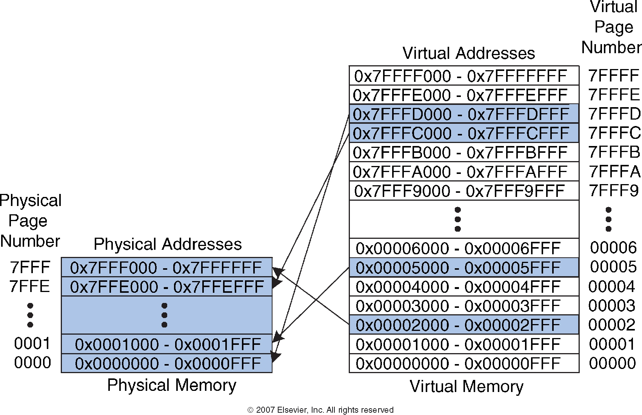
Virtual Memory Example
What is the physical address of virtual address 0x247C?
VPN = 0x2
VPN 0x2 maps to PPN 0x7FFF
The lower 12 bits (page offset) is the same for virtual and physical addresses (0x47C)
Physical address = 0x7FFF47C

Slide 56
How do we translate addresses?
Page table
Has entry for each virtual page
Each entry has:
Valid bit: whether the virtual page is located in physical memory (if not, it must be fetched from the hard disk)
Physical page number: where the page is located

Slide 57
Page Table Example

Slide 58
Page Table Example 1
What is the physical address of virtual address 0x5F20?

Slide 59
Page Table Example 1
What is the physical address of virtual address 0x5F20?
VPN = 5
Entry 5 in page table indicates VPN 5 is in physical page 1
Physical address is 0x1F20

Slide 60
Page Table Example 2
What is the physical address of virtual address 0x73E0?

Slide 61
Page Table Example 2
What is the physical address of virtual address 0x73E0?
VPN = 7
Entry 7 in page table is invalid, so the page is not in physical memory
The virtual page must be swapped into physical memory from disk

Slide 62
Page Table Challenges
Page table is large
usually located in physical memory
Each load/store requires two main memory accesses:
one for translation (page table read)
one to access data (after translation)
Cuts memory performance in half
Unless we get clever…

Slide 63
Translation Lookaside Buffer (TLB)
Use a translation lookaside buffer (TLB)
Small cache of most recent translations
Reduces number of memory accesses required for most loads/stores from two to one

Slide 64
Translation Lookaside Buffer (TLB)
Page table accesses have a lot of temporal locality
Data accesses have temporal and spatial locality
Large page size, so consecutive loads/stores likely to access same page
TLB
Small: accessed in < 1 cycle
Typically 16 - 512 entries
Fully associative
> 99 % hit rates typical
Reduces # of memory accesses for most loads and stores from 2 to 1

Slide 65
Example Two-Entry TLB

Slide 66
Memory Protection
Multiple programs (processes) run at once
Each process has its own page table
Each process can use entire virtual address space without worrying about where other programs are
A process can only access physical pages mapped in its page table – can’t overwrite memory from another process

Slide 67
Virtual Memory Summary
Virtual memory increases capacity
A subset of virtual pages are located in physical memory
A page table maps virtual pages to physical pages – this is called address translation
A TLB speeds up address translation
Using different page tables for different programs provides memory protection

