Slide 1
Introduction to the FPGA and Labs
Notes:
I am a doctoral student of Professor Capkun

Slide 2
Lab Sessions
In HG E 26.1 and E 26.3
Tuesday 15:15-17:00 (also in HG E 19)
Wednesday 15:15-17:00
Friday 08:15-10:00
Friday 10:15-12:00
There is enough seating for you to hop around occasionally

Slide 3
Labs in this Course
9 labs, 25 points in total
We will put the lab manuals online
Grading
No need to hand in the reports! The questions are optional
The assistants will check your work and note down your grade
You should finish the labs within 1 week after they are announced
We want to help you successfully complete all the labs!
Notes:
Feel free to let us know if you have issues
Assistant next year
Individual questions
Any questions?

Slide 4
What will we learn?
What are programmable logic devices?
We will use a Field Programmable Gate Array (FPGA) in the exercises, what is this FPGA?
How does an FPGA work?
Information about the FPGA board we will use
Using Vivado to program the FPGA board
What will we do in the labs?
Notes:
High-level last week
Basic building blocks
Learn with the FPGA programming

Slide 5
Logic Arrays
Programmable logic arrays (PLAs)
AND array followed by OR array
Perform combinational logic only
Fixed internal connections
Field programmable gate arrays (FPGAs)
Array of configurable logic blocks (CLBs)
Perform combinational and sequential logic
Programmable internal connections
Notes:
Combinational vs sequential
Example: counter

Slide 6
Programming PLAs
Show how the PLA can be configured to realize:
X = (A ∙ B ∙ C) + (A ∙ B ∙ C)
Y = A ∙ B

Slide 7
PLAs: Dot Notation

Slide 8
FPGAs: Field Programmable Gate Arrays
Composed of:
CLBs (Configurable Logic Blocks): perform logic
IOBs (Input/Output Buffers): interface with outside world
Programmable interconnection: connect CLBs and IOBs
Some FPGAs include other building blocks such as: multipliers and RAMs

Slide 9
Typical FPGA Schematic

Slide 10
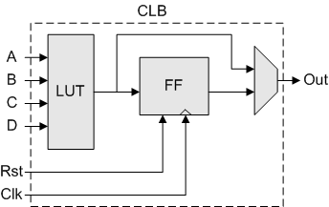
CLBs: Configurable Logic Blocks
Composed of:
LUTs (LookUp Tables): perform combinational logic
Flip-flops (FF): perform sequential functions
Multiplexers: connect LUTs and flip-flops
Notes:
More details tomorrow and coming weeks

Slide 11
CLB Configuration Example
Show how the CLB can be configured to realize:
X = (A ∙ B ∙ C) + (A ∙ B ∙ C)
Y = A ∙ B

Slide 12
CLB Configuration Example
Show how the CLB can be configured to realize:
X = (A ∙ B ∙ C) + (A ∙ B ∙ C)
Y = A ∙ B

Slide 13
FPGA Design Flow
A CAD tool (such as Vivado) is used to design and implement a digital system.
The user enters the design using schematic entry or an HDL.
Correct functionality is verified using simulation
A synthesis tool maps your description onto the FPGA.
The result is a bitfile that contains configures the CLBs and the connections between them and the IOBs.
The bitfile is downloaded to the FPGA

Slide 14
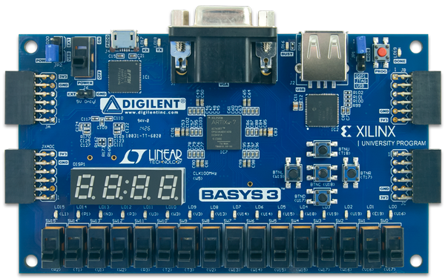
The FPGA board for the Lab Exercises
Each lab group will use an FPGA board for the exercises.
microUSB
(power/programming)
Video out
USB
Power switch
FPGA chip
Buttons
Seven-segment
displays
LEDs
Switches

Slide 15
What exactly is this FPGA board?
Contains a Programmable Logic Device (FPGA)
Various Interfaces
Switches and Lights
Video (VGA) Interface
Keyboard/Mouse Interface
Support Circuits
Circuits to store the configuration
Power and Clock for all the components

Slide 16
What will we do with the FPGA Board ?
At the end of the exercises, we will have built a 32-bit microprocessor running on the FPGA board.
It will be a small processor, but it will be able to execute small programs.
Each week we will have a new exercise.
Not all exercises will require the board.
You are encouraged to experiment with the board on your own.
We may have some extra boards for those who are interested
It is not possible to destroy the board by programming!

Slide 17
Lab 1
Draw a comparator circuit on paper
Compare two inputs and output 1 if they are all the same
No FPGA programming, but you can try out the board

Slide 18
Lab 2
Design a Full Adder and a 4-bit Adder
Combinational circuit
Full Adder
Takes 2 bits and output their sum and carry
4-bit Adder
Instantiate 4 Full Adders to add 2 4-bit values
Use FPGA boards
Input: switches
Output: LEDs

Slide 19
Lab 3
Show your results from Lab 2 on a seven segment display

Slide 20
Lab 4
Implement a finite state machine using sequential circuit
Blinking LEDs for a car’s turn signals

Slide 21
Lab 5
Towards implementing your very first processor
Implement your own Arithmetic and Logic Unit (ALU)
An ALU is an important part of the CPU
Arithmetic operations: add, subtract, multiply, compare, …
Logic operations: AND, OR, …

Slide 22
Lab 6
Simulate your ALU design using a testbench
Validate that your ALU is functionally correct
Learn how to find and resolve problems in your circuit

Slide 23
Lab 7
Assembly coding
MIPS
Implement an program which you will later use to run on your processor
Calculate sum or number ranges
Image manipulation

Slide 24
Lab 8
Learn how a processor is built
Complete your first design of a MIPS processor
Run a “snake”program

Slide 25
Lab 9
Improve the performance of your MIPS processor by adding some new instructions
Multiplication
Bit shifting

Slide 26
Vivado
Design circuits using Hardware Description Langauge (HDL)
Hardware Description Languages
Verilog (this is the one we use in this course!)
VHDL
FPGA Board
Systhesis
Implementation
Program
Simulation
Testbenches

Slide 27
Typical design process on the FPGA board
Create a Vivado Project
Implement your circuit using Verilog code
Use the constraint file to specify which I/O to use
Implement your circuit
Generate the bitstream
Program to the board (target)

Slide 28
A Short Tutorial
The AND gate
The output is true (1) only if both inputs are true (1).
Notes:
Reading assignment: binary numbers

Slide 29
Summary
Quick introduction of the FPGA
Short Tutorial on FPGA programming
Getting started guide: https://reference.digilentinc.com/learn/programmable-logic/tutorials/basys-3-getting-started/start
Demo: https://reference.digilentinc.com/reference/programmable-logic/basys-3/start
Overview of the labs
Tomorrow:
Combinational circuits

