Slide 1
Sequential Logic Design

Slide 2
What will we learn?
How can a circuit remember a value
Different types of memorizing elements
Finite State Machines
How to write Finite State Machines in Verilog

Slide 3
Introduction
Outputs of sequential logic depend on current and prior input values – it has memory.
Sequential Circuits:
Give sequence to events which allows ordering of operations
Need a special circuit to store the current state of circuit
Controlling when to change state
ASYNCHROUNOUS As soon as circuit finishes, it moves to next state
SYNCHRONOUS A global control signal (clock) that tells everyone when to move
(anarchic)
(communist) – THIS LECTURE

Slide 4
Combinational + Memory = Sequential
Sequential Circuit
Combinational
Circuit
inputs
outputs
Memory
Element
We know Combinational Circuits, just need some MEMORY

Slide 5
How can a circuit remember?
Bistable circuits can have two distinct states
Once they are in one state, they will remain there.
The Loop keeps the state stable
0
1
0 = State 0

Slide 6
How can a circuit remember?
Bistable circuits can have two distinct states
Once they are in one state, they will remain there.
The Loop keeps the state stable
1
0
1 = State 1

Slide 7
How can a circuit remember?
Bistable circuits can have two distinct states
Once they are in one state, they will remain there.
But how can we move from one state to another?

Slide 8
How can a circuit remember?
Bistable circuits can have two distinct states
Once they are in one state, they will remain there.
But how can we move from one state to another?
We add one switch to break the loop and at the same time add another switch that connects an input to the circuit

Slide 9
The D Latch
D Latch is the basic bi-stable circuit used in modern CMOS.
The clock controls the switches. Only one is active at a time.
Traditionally the input is called D (Data) and the output Q
$$D$$
$$Q$$
$$Clk$$

Slide 10
The D Latch has two modes
Latch mode, loop is active, input disconnected, keeps state
$$D$$
$$Q$$
$$Q$$
$$Q$$

Slide 11
The D Latch has two modes
Latch mode, loop is active, input disconnected, keeps state
Transparent mode, loop is inactive, input is connected and propagates to output
$$D$$
$$Q$$
$$Q$$
$$Q$$
$$D$$
$$D$$
$$D$$
$$D$$

Slide 12
Summary D Latch
Simple bi-stable circuit
Can be used to store a 0 or a 1.
Has two modes
Transparent mode: input propagates to output
Latch mode: the output is stored (also called opaque mode)
The clock controls the modes of operation.
Depending on the type, it might be latch is transparent when Clk=1 or latch is transparent when Clk=0

Slide 13
D Latch is commonly used... but…
It is a bit tricky to use
There is a long transparent time, latch is not storing
Problematic if we have a series of latches that form a pipeline
Usually used with alternating clocks for each stage
If one latch is transparent at CLK=0 the next one is latching
Make sure there are not two transparent latches in a row
A Flip-Flop (FF) is a circuit that combines two latches
A Master latch that is transparent when CLK=0
And a Slave latch that is transparent when CLK=1 (or vice versa)
Throughout this lecture we will use Flip-Flops

Slide 14
Rising edge trigerred D Flip-Flop
Two inputs: CLK, D
Function
The flip-flop “samples” D on the rising edge of CLK
When CLK rises from 0 to 1, D passes through to Q
Otherwise, Q holds its previous value
Q changes only on the rising edge of CLK
A flip-flop is called an edge-triggered device because it is activated on the clock edge

Slide 15
D Flip-Flop Internal Circuit
Two back-to-back latches (L1 and L2) controlled by complementary clocks
When CLK = 0
L1 is transparent
L2 is opaque
D passes through to N1
When CLK = 1
L2 is transparent
L1 is opaque
N1 passes through to Q
Thus, on the edge of the clock (when CLK rises from 0 1)
D passes through to Q

Slide 16
Registers
Multiple parallel flip-flops that store more than 1 bit

Slide 17
Enabled Flip-Flops
Inputs: CLK, D, EN
The enable input (EN) controls when new data (D) is stored
Function
EN = 1: D passes through to Q on the clock edge
EN = 0: the flip-flop retains its previous state

Slide 18
Resettable Flip-Flops
Inputs: CLK, D, Reset
The Reset is used to set the output to 0.
Function:
Reset = 1: Q is forced to 0
Reset = 0: the flip-flop behaves like an ordinary D flip-flop

Slide 19
Resettable Flip-Flops
Two types:
Synchronous: resets at the clock edge only
Asynchronous: resets immediately when Reset = 1
Asynchronously resettable flip-flop requires changing the internal circuitry of the flip-flop (see Exercise 3.10)
Synchronously resettable flip-flop?

Slide 20
Resettable Flip-Flops
Two types:
Synchronous: resets at the clock edge only
Asynchronous: resets immediately when Reset = 1
Asynchronously resettable flip-flop requires changing the internal circuitry of the flip-flop (see Exercise 3.10)
Synchronously resettable flip-flop?

Slide 21
Settable Flip-Flops
Inputs: CLK, D, Set
Function:
Set = 1: Q is set to 1
Set = 0: the flip-flop behaves like an ordinary D flip-flop

Slide 22
Synchronous Sequential Logic Design
Breaks cyclic paths by inserting registers
These registers contain the state of the system
The state changes at the clock edge, so we say the system is synchronized to the clock
Rules of synchronous sequential circuit composition:
Every circuit element is either a register or a combinational circuit
At least one circuit element is a register
All registers receive the same clock signal
Every cyclic path contains at least one register
Two common synchronous sequential circuits
Finite State Machines (FSMs)
Pipelines

Slide 23
Finite State Machine (FSM) consists of:
State register:
Store the current state and
Load the next state at the clock edge
Sequential circuit
Next state logic
Determines what the next state will be
Combinational circuit
Output logic
Generates the outputs
Combinational Circuit

Slide 24
Finite State Machine (FSM)
FSMs get their name because a circuit with k registers can be in one of a finite number (2^{k}) of unique states.

Slide 25
Finite State Machines (FSMs)
Next state is determined by the current state and the inputs
Two types of finite state machines differ in the output logic:
Moore FSM: outputs depend only on the current state
Mealy FSM: outputs depend on the current state and the inputs

Slide 26
Finite State Machine Example
Traffic light controller
2 inputs: Traffic sensors: T_{A}, T_{B} (TRUE when there’s traffic)
2 outputs: Lights: L_{A}, L_{B}

Slide 27
FSM Black Box
Inputs: CLK, Reset, T_{A}, T_{B}
Outputs: L_{A}, L_{B}

Slide 28
FSM State Transition Diagram
Moore FSM: outputs labeled in each state
States: Circles
Transitions: Arcs

Slide 29
FSM State Transition Diagram
Moore FSM: outputs labeled in each state
States: Circles
Transitions: Arcs

Slide 30
FSM State Transition Table
Current State | Inputs |  | Next State
S | T_{A} | T_{B} | S'
S0 | 0 | X
S0 | 1 | X
S1 | X | X
S2 | X | 0
S2 | X | 1
S3 | X | X

Slide 31
FSM State Transition Table
Current State | Inputs |  | Next State
S | T_{A} | T_{B} | S'
S0 | 0 | X | S1
S0 | 1 | X | S0
S1 | X | X | S2
S2 | X | 0 | S3
S2 | X | 1 | S2
S3 | X | X | S0

Slide 32
FSM Encoded State Transition Table
Current State |  | Inputs |  | Next State
S₁ | S₀ | T_{A} | T_{B} | S'₁ | S'₀
0 | 0 | 0 | X
0 | 0 | 1 | X
0 | 1 | X | X
1 | 0 | X | 0
1 | 0 | X | 1
1 | 1 | X | X
State | Encoding
S0 | 00
S1 | 01
S2 | 10
S3 | 11

Slide 33
FSM Encoded State Transition Table
Current State |  | Inputs |  | Next State
S₁ | S₀ | T_{A} | T_{B} | S'₁ | S'₀
0 | 0 | 0 | X | 0 | 1
0 | 0 | 1 | X | 0 | 0
0 | 1 | X | X | 1 | 0
1 | 0 | X | 0 | 1 | 1
1 | 0 | X | 1 | 1 | 0
1 | 1 | X | X | 0 | 0
State | Encoding
S0 | 00
S1 | 01
S2 | 10
S3 | 11

Slide 34
FSM Encoded State Transition Table
Current State |  | Inputs |  | Next State
S₁ | S₀ | T_{A} | T_{B} | S'₁ | S'₀
0 | 0 | 0 | X | 0 | 1
0 | 0 | 1 | X | 0 | 0
0 | 1 | X | X | 1 | 0
1 | 0 | X | 0 | 1 | 1
1 | 0 | X | 1 | 1 | 0
1 | 1 | X | X | 0 | 0
State | Encoding
S0 | 00
S1 | 01
S2 | 10
S3 | 11
S₁’ = (S₁ ∙ S₀) + (S₁ ∙ S₀ ∙ T_{B}) + (S₁ ∙ S₀ ∙ T_{B})
S₀’ = (S₁ ∙ S₀ ∙ T_{A}) + (S₁ ∙ S₀ ∙ T_{B})

Slide 35
FSM Encoded State Transition Table
Current State |  | Inputs |  | Next State
S₁ | S₀ | T_{A} | T_{B} | S'₁ | S'₀
0 | 0 | 0 | X | 0 | 1
0 | 0 | 1 | X | 0 | 0
0 | 1 | X | X | 1 | 0
1 | 0 | X | 0 | 1 | 1
1 | 0 | X | 1 | 1 | 0
1 | 1 | X | X | 0 | 0
State | Encoding
S0 | 00
S1 | 01
S2 | 10
S3 | 11
S₁’ = S₁ xor S₀ Simplification (Inspection or K-Maps)
S₀’ = (S₁ ∙ S₀ ∙ T_{A}) + (S₁ ∙ S₀ ∙ T_{B})

Slide 36
FSM Output Table
Current State |  | Outputs
S₁ | S₀ | L_{A} | L_{B}
0 | 0
0 | 1
1 | 0
1 | 1

Slide 37
FSM Output Table
Current State |  | Outputs
S₁ | S₀ | L_{A} | L_{B}
0 | 0 | green | red
0 | 1 | yellow | red
1 | 0 | red | green
1 | 1 | red | yellow
Output | Encoding
green | 00
yellow | 01
red | 10

Slide 38
FSM Output Table
Current State |  | Outputs
S₁ | S₀ | L_{A1} | L_{A0} | L_{B1} | L_{B0}
0 | 0 | 0 | 0 | 1 | 0
0 | 1 | 0 | 1 | 1 | 0
1 | 0 | 1 | 0 | 0 | 0
1 | 1 | 1 | 0 | 0 | 1
Output | Encoding
green | 00
yellow | 01
red | 10

Slide 39
FSM Output Table
Current State |  | Outputs
S₁ | S₀ | L_{A1} | L_{A0} | L_{B1} | L_{B0}
0 | 0 | 0 | 0 | 1 | 0
0 | 1 | 0 | 1 | 1 | 0
1 | 0 | 1 | 0 | 0 | 0
1 | 1 | 1 | 0 | 0 | 1
Output | Encoding
green | 00
yellow | 01
red | 10
L_{A1} = S₁
L_{A0} = S₁ ∙ S₀
L_{B1} = S₁
L_{B0} = S₁ ∙ S₀

Slide 40
FSM Schematic: State Register

Slide 41
FSM Schematic: Next State Logic

Slide 42
FSM Schematic: Output Logic

Slide 43
FSM Timing Diagram

Slide 44
FSM State Encoding
Binary encoding: i.e., for four states, 00, 01, 10, 11
One-hot encoding
One state bit per state
Only one state bit is HIGH at once
I.e., for four states, 0001, 0010, 0100, 1000
Requires more flip-flops
Often next state and output logic is simpler

Slide 45
Moore vs. Mealy FSM
Alyssa P. Hacker has a snail that crawls down a paper tape with 1’s and 0’s on it. The snail smiles whenever the last four digits it has crawled over are 1101. Design Moore and Mealy FSMs of the snail’s brain.

Slide 46
State Transition Diagrams (snail - 1101)
Mealy FSM: arcs indicate input/output

Slide 47
FSM Design Procedure
Prepare
Identify the inputs and outputs
Sketch a state transition diagram
Write a state transition table
Select state encodings
For a Moore machine:
Rewrite the state transition table with the selected state encodings
Write the output table
For a Mealy machine:
Rewrite the combined state transition and output table with the selected state encodings
Write Boolean equations for the next state and output logic
Sketch the circuit schematic

Slide 48
Sequential Logic Design

Slide 49
Last Week in Verilog
We have seen an overview of Verilog
Discussed behavioral and structural modeling
Showed combinational logic constructs
This week
Sequential circuit description in Verilog
Developing testbenches for simulation

Slide 50
Combinational + Memory = Sequential
Sequential Circuit
Combinational
Circuit
inputs
outputs
Memory
Element
We know Combinational Circuits, just need some MEMORY

Slide 51
Sequential Logic in Verilog
Define blocks that have memory
Flip-Flops, Latches, Finite State Machines
Sequential Logic is triggered by a ‘CLOCK’ event
Latches are sensitive to level of the signal
Flip-flops are sensitive to the transitioning of clock
Combinational constructs are not sufficient
We need new constructs:
always
initial

Slide 52
always Statement, Defining Processes
always @ (sensitivity list)
statement;
Whenever the event in the sensitivity list occurs, the statement is executed

Slide 53
Example: D Flip-Flop
module flop(input clk,
input [3:0] d,
output reg [3:0] q);
always @ (posedge clk)
q <= d; // pronounced “q gets d”
endmodule

Slide 54
Example: D Flip-Flop
module flop(input clk,
input [3:0] d,
output reg [3:0] q);
always @ (posedge clk)
q <= d; // pronounced “q gets d”
endmodule
The posedge defines a rising edge (transition from 0 to 1).
This process will trigger only if the clk signal rises.
Once the clk signal rises: the value of d will be copied to q

Slide 55
Example: D Flip-Flop
module flop(input clk,
input [3:0] d,
output reg [3:0] q);
always @ (posedge clk)
q <= d; // pronounced “q gets d”
endmodule
‘assign’ statement is not used within always block
The <= describes a ‘non-blocking’ assignment
We will see the difference between ‘blocking assignment’ and ‘non-blocking’ assignment in a while

Slide 56
Example: D Flip-Flop
module flop(input clk,
input [3:0] d,
output reg [3:0] q);
always @ (posedge clk)
q <= d; // pronounced “q gets d”
endmodule
Assigned variables need to be declared as reg
The name reg does not necessarily mean that the value is a register. (It could be, it does not have to be).
We will see examples later

Slide 57
D Flip-Flop with Asynchronous Reset
module flop_ar (input clk,
input reset,
input [3:0] d,
output reg [3:0] q);
always @ (posedge clk, negedge reset)
begin
if (reset == ‘0’) q <= 0; // when reset
else q <= d; // when clk
end
endmodule
In this example: two events can trigger the process:
A rising edge on clk
A falling edge on reset

Slide 58
D Flip-Flop with Asynchronous Reset
module flop_ar (input clk,
input reset,
input [3:0] d,
output reg [3:0] q);
always @ (posedge clk, negedge reset)
begin
if (reset == ‘0’) q <= 0; // when reset
else q <= d; // when clk
end
endmodule
For longer statements a begin end pair can be used
In this example it was not necessary
The always block is highlighted

Slide 59
D Flip-Flop with Asynchronous Reset
module flop_ar (input clk,
input reset,
input [3:0] d,
output reg [3:0] q);
always @ (posedge clk, negedge reset)
begin
if (reset == ‘0’) q <= 0; // when reset
else q <= d; // when clk
end
endmodule
First reset is checked, if reset is 0, q is set to 0.
This is an ‘asynchronous’ reset as the reset does not care what happens with the clock
If there is no reset then normal assignment is made

Slide 60
D Flip-Flop with Synchronous Reset
module flop_sr (input clk,
input reset,
input [3:0] d,
output reg [3:0] q);
always @ (posedge clk)
begin
if (reset == ‘0’) q <= 0; // when reset
else q <= d; // when clk
end
endmodule
The process is only sensitive to clock
Reset only happens when the clock rises. This is a ‘synchronous’ reset
A small change, has a large impact on the outcome

Slide 61
D Flip-Flop with Enable and Reset
module flop_ar (input clk,
input reset,
input en,
input [3:0] d,
output reg [3:0] q);
always @ (posedge clk, negedge reset)
begin
if (reset == ‘0’) q <= 0; // when reset
else if (en) q <= d; // when en AND clk
end
endmodule
A flip-flop with enable and reset
Note that the en signal is not in the sensitivity list
Only when “clk is rising” AND “en is 1” data is stored

Slide 62
Example: D Latch
module latch (input clk,
input [3:0] d,
output reg [3:0] q);
always @ (clk, d)
if (clk) q <= d; // latch is transparent when
// clock is 1
endmodule

Slide 63
Summary: Sequential Statements so far
Sequential statements are within an ‘always’ block
The sequential block is triggered with a change in the sensitivity list
Signals assigned within an always must be declared as reg
We use <= for (non-blocking) assignments and do not use ‘assign’ within the always block.

Slide 64
Summary: Basics of always Statements
module example (input clk,
input [3:0] d,
output reg [3:0] q);
wire [3:0] normal; // standard wire
reg [3:0] special; // assigned in always
always @ (posedge clk)
special <= d; // first FF array
assign normal = ~ special; // simple assignment
always @ (posedge clk)
q <= normal; // second FF array
endmodule
You can have many always blocks

Slide 65
Summary: Basics of always Statements
module example (input clk,
input [3:0] d,
output reg [3:0] q);
wire [3:0] normal; // standard wire
reg [3:0] special; // assigned in always
always @ (posedge clk)
special <= d; // first FF array
assign normal = ~ special; // simple assignment
always @ (posedge clk)
q <= normal; // second FF array
endmodule
Assignments are different within always blocks

Slide 66
Why does an always Statement Memorize?
module flop (input clk,
input [3:0] d,
output reg [3:0] q);
always @ (posedge clk)
begin
q <= d; // when clk rises copy d to q
end
endmodule
This statement describes what happens to signal q
… but what happens when clock is not rising?

Slide 67
Why does an always Statement Memorize?
module flop (input clk,
input [3:0] d,
output reg [3:0] q);
always @ (posedge clk)
begin
q <= d; // when clk rises copy d to q
end
endmodule
This statement describes what happens to signal q
… but what happens when clock is not rising?
The value of q is preserved (memorized)

Slide 68
Why does an always Statement Memorize?
module comb (input inv,
input [3:0] data,
output reg [3:0] result);
always @ (inv, data) // trigger with inv, data
if (inv) result <= ~data;// result is inverted data
else result <= data; // result is data
endmodule
This statement describes what happens to signal result
When inv is 1, result is ~data
What happens when inv is not 1 ?

Slide 69
Why does an always Statement Memorize?
module comb (input inv,
input [3:0] data,
output reg [3:0] result);
always @ (inv, data) // trigger with inv, data
if (inv) result <= ~data;// result is inverted data
else result <= data; // result is data
endmodule
This statement describes what happens to signal result
When inv is 1, result is ~data
When inv is not 1, result is data
Circuit is combinational (no memory)
The output (result) is defined for all possible inputs (inv data)

Slide 70
always Blocks for Combinational Circuits
If the statements define the signals completely, nothing is memorized, block becomes combinational.
Care must be taken, it is easy to make mistakes and unintentionally describe memorizing elements (latches).
Always blocks allow powerful statements
if .. then .. else
case
Use always blocks only if it makes your job easier

Slide 71
Always Statement is not Always Practical…
reg [31:0] result;
wire [31:0] a, b, comb;
wire sel,
always @ (a, b, sel) // trigger with a, b, sel
if (sel) result <= a; // result is a
else result <= b; // result is b
assign comb = sel ? a : b;
endmodule
Both statements describe the same multiplexer
In this case, the always block is more work

Slide 72
Sometimes Always Statements are Great
module sevensegment (input [3:0] data,
output reg [6:0] segments);
always @ ( * ) // * is short for all signals
case (data) // case statement
4'd0: segments = 7'b111_1110; // when data is 0
4'd1: segments = 7'b011_0000; // when data is 1
4'd2: segments = 7'b110_1101;
4'd3: segments = 7'b111_1001;
4'd4: segments = 7'b011_0011;
4'd5: segments = 7'b101_1011;
// etc etc
default: segments = 7'b000_0000; // required
endcase
endmodule

Slide 73
The case Statement
Like if .. then .. else can only be used in always blocks
The result is combinational only if the output is defined for all cases
Did we mention this before ?
Always use a default case to make sure you did not forget a case (which would infer a latch)
Use casez statement to be able to check for don’t cares
See book page 202, example 4.28

Slide 74
Non-blocking and Blocking Statements
Non-blocking
Blocking
always @ (a)
begin
a <= 2’b01;
b <= a;
// all assignments are made here
// b is not (yet) 2’b01
end
always @ (a)
begin
a = 2’b01;
// a is 2’b01
b = a;
// b is now 2’b01 as well
end
Values are assigned at the end of the block.
All assignments are made in parallel, process flow is not-blocked.
Value is assigned immediately.
Process waits until the first assignment is complete, it blocks progress.

Slide 75
Why use (Non)-Blocking Statements
There are technical reasons why both are required
It is out of the scope of this course to discuss these
Blocking statements allow sequential descriptions
More like a programming language
If the sensitivity list is correct, blocks with non-blocking statements will always evaluate to the same result
It may require some additional iterations

Slide 76
Example: Blocking Statements
Assume all inputs are initially ‘0’
always @ ( * )
begin
p = a ^ b ; // p = 0
g = a & b ; // g = 0
s = p ^ cin ; // s = 0
cout = g | (p & cin) ; // cout = 0
end

Slide 77
Example: Blocking Statements
Now a changes to ‘1’
always @ ( * )
begin
p = a ^ b ; // p = 1
g = a & b ; // g = 0
s = p ^ cin ; // s = 1
cout = g | (p & cin) ; // cout = 0
end
The process triggers
All values are updated in order
At the end, s = 1

Slide 78
Same Example: Non-Blocking Statements
Assume all inputs are initially ‘0’
always @ ( * )
begin
p <= a ^ b ; // p = 0
g <= a & b ; // g = 0
s <= p ^ cin ; // s = 0
cout <= g | (p & cin) ; // cout = 0
end

Slide 79
Same Example: Non-Blocking Statements
Now a changes to ‘1’
always @ ( * )
begin
p <= a ^ b ; // p = 1
g <= a & b ; // g = 0
s <= p ^ cin ; // s = 0
cout <= g | (p & cin) ; // cout = 0
end
The process triggers
All assignments are concurrent
When s is being assigned, p is still 0, result is still 0

Slide 80
Same Example: Non-Blocking Statements
After the first iteration p has changed to ‘1’ as well
always @ ( * )
begin
p <= a ^ b ; // p = 1
g <= a & b ; // g = 0
s <= p ^ cin ; // s = 1
cout <= g | (p & cin) ; // cout = 0
end
Since there is a change in p, process triggers again
This time s is calculated with p=1
The result is correct after the second iteration

Slide 81
Rules for Signal Assignment
Use always @(posedge clk) and non-blocking assignments (<=) to model synchronous sequential logic
always @ (posedge clk)
q <= d; // nonblocking
Use continuous assignments (assign …)to model simple combinational logic.
assign y = a & b;

Slide 82
Rules for Signal Assignment (cont)
Use always @ (*) and blocking assignments (=) to model more complicated combinational logic where the always statement is helpful.
Do not make assignments to the same signal in more than one always statement or continuous assignment statement

Slide 83
Finite State Machines (FSMs)
Each FSM consists of three separate parts:
next state logic
state register
output logic

Slide 84
Finite State Machine (FSM) consists of:
State register:
Store the current state and
Load the next state at the clock edge
Sequential circuit
Next state logic
Determines what the next state will be
Combinational circuit
Output logic
Generates the outputs
Combinational Circuit

Slide 85
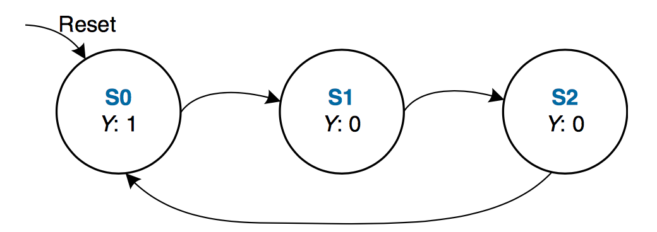
FSM Example 1: Divide by 3
The output Y is HIGH for one clock cycle out of every 3. In other words, the output divides the frequency of the clock by 3.

Slide 86
FSM in Verilog, Definitions
module divideby3FSM (input clk,
input reset,
output q);
reg [1:0] state, nextstate;
parameter S0 = 2'b00;
parameter S1 = 2'b01;
parameter S2 = 2'b10;
We define state and nextstate as 2-bit reg
The parameter descriptions are optional, it makes reading easier

Slide 87
FSM in Verilog, State Register
// state register
always @ (posedge clk, posedge reset)
if (reset) state <= S0;
else state <= nextstate;
This part defines the state register (memorizing process)
Sensitive to only clk, reset
In this example reset is active when ‘1’

Slide 88
FSM in Verilog, Next State Calculation
// next state logic
always @ (*)
case (state)
S0: nextstate = S1;
S1: nextstate = S2;
S2: nextstate = S0;
default: nextstate = S0;
endcase
Based on the value of state we determine the value of nextstate
An always .. case statement is used for simplicity.

Slide 89
FSM in Verilog, Output Assignments
// output logic
assign q = (state == S0);
In this example, output depends only on state
Moore type FSM
We used a simple combinational assign

Slide 90
FSM in Verilog, Whole Code
module divideby3FSM (input clk, input reset, output q);
reg [1:0] state, nextstate;
parameter S0 = 2'b00;
parameter S1 = 2'b01;
parameter S2 = 2'b10;
always @ (posedge clk, posedge reset) // state register
if (reset) state <= S0;
else state <= nextstate;
always @ (*) // next state logic
case (state)
S0: nextstate = S1;
S1: nextstate = S2;
S2: nextstate = S0;
default: nextstate = S0;
endcase
assign q = (state == S0); // output logic
endmodule

Slide 91
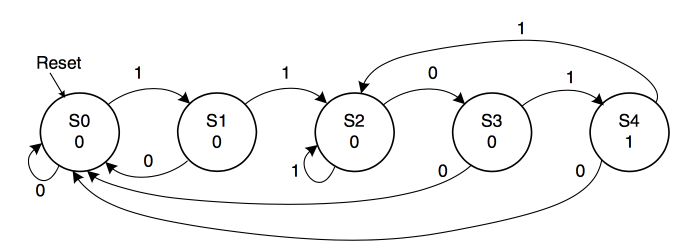
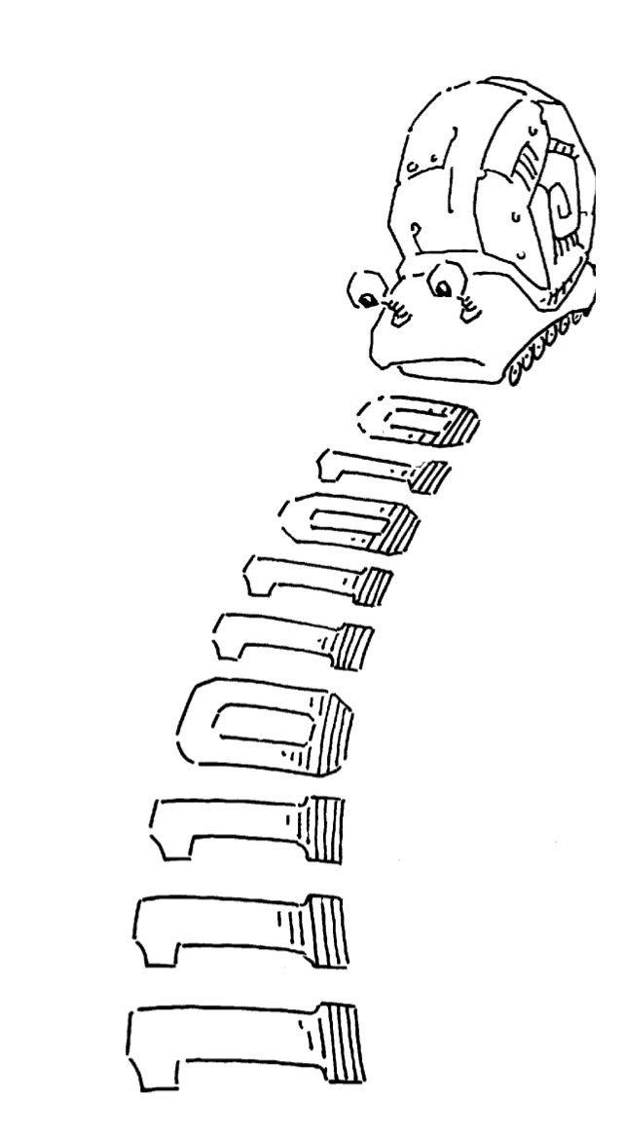
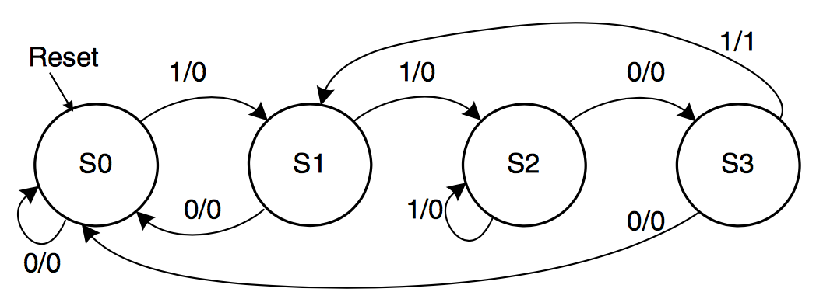
FSM Example 2: Smiling Snail
Alyssa P. Hacker has a snail that crawls down a paper tape with 1’s and 0’s on it. The snail smiles whenever the last four digits it has crawled over are 1101.
Moore
Mealy

Slide 92
FSM Example 2: Verilog Definitions
module smilingsnail (input clk,
input reset,
input a,
output y);
reg [1:0] state, nextstate;
parameter S0 = 2'b00;
parameter S1 = 2'b01;
parameter S2 = 2'b10;
parameter S3 = 2’b11;
a/y

Slide 93
FSM Example 2: State Register
// state register
always @ (posedge clk, posedge reset)
if (reset) state <= S0;
else state <= nextstate;
This part defines the state register (memorizing process)
Sensitive to only clk, reset
In this example reset is active when ‘1’

Slide 94
FSM Example 2: Next State Calculation
// next state logic
always @ (*)
case (state)
S0: if (a) nextstate = S1;
else nextstate = S0;
S1: if (a) nextstate = S2;
else nextstate = S0;
S2: if (a) nextstate = S2;
else nextstate = S3;
S3: if (a) nextstate = S1;
else nextstate = S0;
default: nextstate = S0;
endcase

Slide 95
FSM Example 2: Output Assignments
// output logic
assign y = (a & state == S3);
In this example, output depends on state and input
Mealy type FSM
We used a simple combinational assign

Slide 96
FSM Example 2: Whole Code
module smilingsnail (input clk,
input reset,
input a,
output y);
reg [1:0] state, nextstate;
parameter S0 = 2'b00;
parameter S1 = 2'b01;
parameter S2 = 2'b10;
parameter S3 = 2’b11;
// state register
always @ (posedge clk, posedge reset)
if (reset) state <= S0;
else state <= nextstate;
// next state logic
always @ (*)
case (state)
S0: if (a) nextstate = S1;
else nextstate = S0;
S1: if (a) nextstate = S2;
else nextstate = S0;
S2: if (a) nextstate = S2;
else nextstate = S3;
S3: if (a) nextstate = S1;
else nextstate = S0;
default: nextstate = S0;
endcase
// output logic
assign y = (a & state == S3);
endmodule

Slide 97
What Did We Learn?
Basics of Defining Sequential Circuits in Verilog
Always statement
Is needed for defining memorizing elements (flip-flops, latches)
Can also be used to define combinational circuits
Blocking vs Non-blocking statements
= assigns the value immediately
<= assigns the value at the end of the block
Writing FSMs
Next state calculation
Determining outputs
State assignment

Slide 98
What Did We Learn?
D Latch is the basic memorizing element
Transparent mode, copies input to output
Latch mode, keeps content
(Rising) Edge Triggered Flip-Flops are more practical
Input is copied to output when the clock rises from 0 to 1
Finite State Machines
Moore, output depends on only the current state
Mealy, output depends on current state and the inputs.
Three Aspects of an FSM
Holds the present state
Calculate the next state
Determine the outputs

Slide 99
Tomorrow…
Timing in Combinational circuits
Propagation and Contamination Delays
Timing for Sequential circuits
Setup and Hold time
How fast can my circuit work?
How timing is modeled in Verilog
Verification using Verilog
How can we make sure the circuit works correctly
Designing Testbenches

